Slide 1

Building & Mining Knowledge Graphs
(KEN4256)
Lecture 4: Knowledge graph completion
Remzi Celebi

Slide 2
Outline
Knowledge graph completion
What is knowledge graph completion?
Different approaches
Applications
Methods
Rule Based Methods
Path Based Methods
Embedding methods

Slide 3
What is knowledge graph completion?

Slide 4
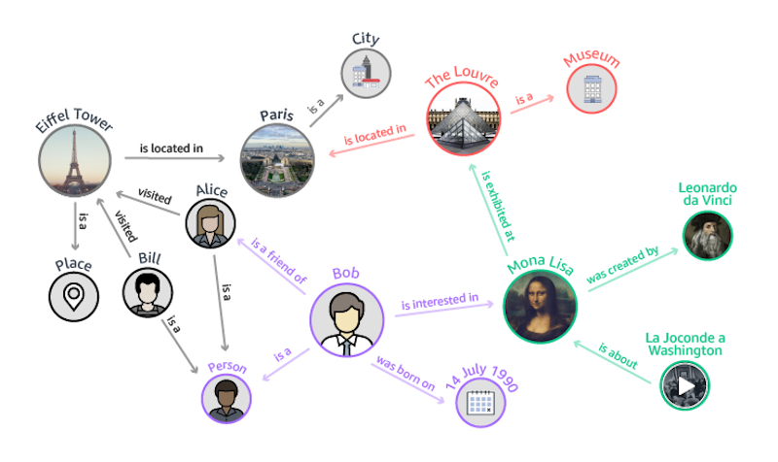
Can we predict missing relations from existing knowledge?
visited
Did Alice also visit The Louvre?
Is Alice a friend of Bill?
friend of

Slide 5
Despite their large sizes, KGs are usually far from complete, which
hampers their usefulness in the applications.

Slide 6
Knowledge Graph Completion
Different viewpoints for KG Completion:
Link Prediction
predicting s given (p, o) or o given (s, p)
(?s, DirectorOf, Psycho), (AlfredHitchcock, DirectorOf, ?o)
Triple Verification (Triple Classification)
Verifying whether an unseen triple fact (s, p, o) is true or not
(AlfredHitchcock, DirectorOf, Psycho) is True or False
Entity Classification
categorize entities into different semantic categories
AlfredHitchcock is a Person, and Psycho a Movie

Slide 7
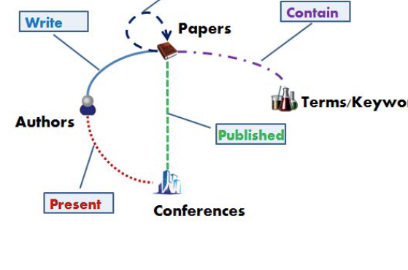
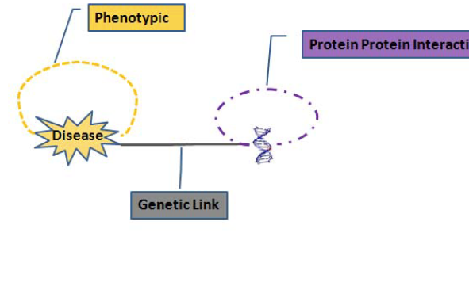
Applications
Scientific publishing: Predict future co-authorship
Biology: Predict genes involved in disease

Slide 8
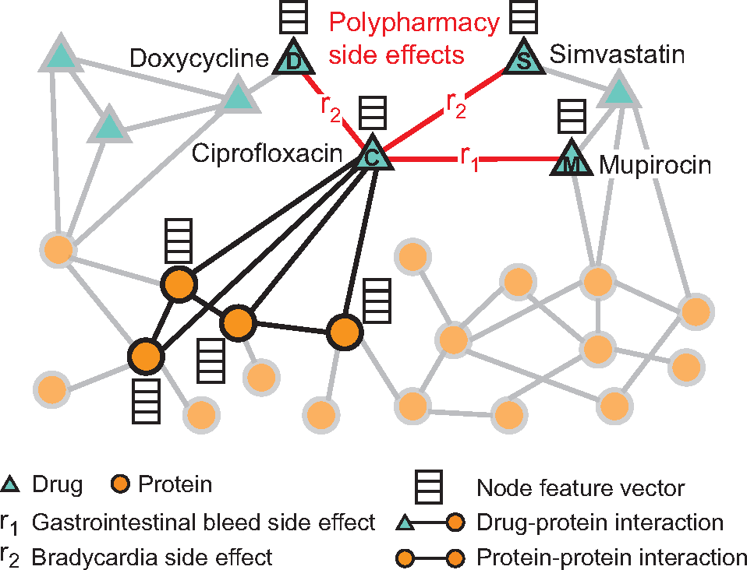
Applications
Predicting polypharmacy side effects
Modeling polypharmacy side effects with graph convolutional networks. Zitnik, Marinka, et al. Bioinformatics 34.13 (2018): i457-i466.

Slide 9
Knowledge Graph Completion Methods
Existing methods can be categorized into two groups:
(1) observed feature models that use observable
properties of graphs, e.g., rule mining systems and path ranking algorithms.
(2) latent feature models, also known as embedding models, that embed a KG into a continuous vector space.

Slide 10
Inference Rules
hasParent(X, Y ) ∧ hasChild(Y, Z) ⇒
hasSibling(X, Z)
hasChild
Mary
David
hasSibling
Rule as SPARQL Statement
hasParent
INSERT {
?x :hasSibling ?z .
}
WHERE{
?x :hasParent ?y .
?y :hasChild ?z .
}
John
Notes:
A simple rule could be defined in form of Horn clauses. These rules can be used to predict missing links.

Slide 11
Rule Mining/Learning
Inductive Logic Programming
Learn a set of first-order Horn clauses (FOIL, 1993)
Lionel Messi
Barcelona F.C.
inLeague
La Liga
playsForTeam
inLeague
Mohamed Salah
Liverpool F.C.
Premier League
playsForTeam
Horn Rule:
playsForTeam(x, y) ∧ inLeague(y, z) ⇒ playsInLeague(x,z)
FOIL:. Quinlan, J. R., & Cameron-Jones, R. M., ECML, page 3-20, 1993
Notes:
Rules might be erroneous and might make incorrect predictions.
rules can be ranked by the ratio of correct versus incorrect predictions

Slide 12
Rule Mining/Learning
Inductive Logic Programming
Learn a set of first-order Horn clauses (FOIL, 1993)
Drawbacks:
Not robust
Not scalable
inLeague
La Liga
Lionel Messi
Barcelona F.C.
playsForTeam
inLeague
Champions League
inLeague
Mohamed Salah
Liverpool F.C.
playsForTeam
Premier League
inLeague
Horn Rule:
playsForTeam(x, y) ∧ inLeague(y, z) ⇒ playsInLeague(x,z)
will make predictions
FOIL:. Quinlan, J. R., & Cameron-Jones, R. M., ECML, page 3-20, 1993
Notes:
Rules might be erroneous and might make incorrect predictions.
rules can be ranked by the ratio of correct versus incorrect predictions

Slide 13
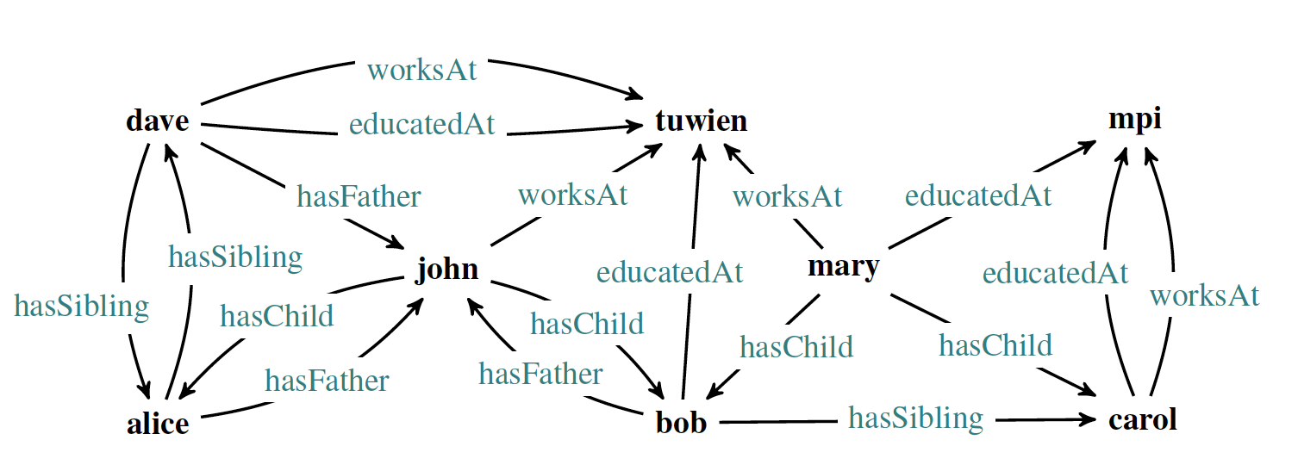
Rule Mining/Learning
Association Rule Mining
the discovery of frequent patterns in a data set and the subsequent transformation of these patterns into rules
confidence under the Partial Completeness Assumption (PCA)
= hits /(misses+hits)
conf(r1) = 2/4
conf(r2) = 1/6
Completeness-aware rule learning from knowledge graphs. Tanon, Thomas Pellissier, et al., 2017.
Notes:
The confidence of a rule is the fraction of facts predicted by the rule that are indeed true in the KG. We have conf(r2) = ⅙, since all people that are predicted to have siblings by r2 already have siblings in the available graph. confidence= hits /(misses+hits).
Other quality metrics such as actionability, and unexpectedness have been proposed.

Slide 14
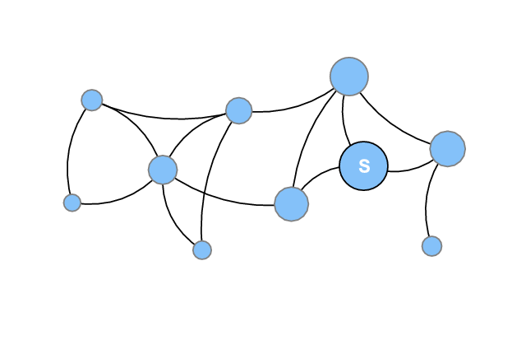
Random Walk with Restart
Imagine a network, and starting at a specific node, you follow the edges randomly.
But with some probability, you “jump” back to the node (restart!).
0.8
If you keep doing the random walk, you will obtain a ranking of other nodes with respect to the start node.
0.3
0.7
0.6
0.8
0.2
0.8
0.4
likelihood of forming a link from the start node.
Ignores edge types
not interpretable
0.1
Start
Notes:
If you recorded the number of times you land on each node,
Problem: Ignores edge types

Slide 15
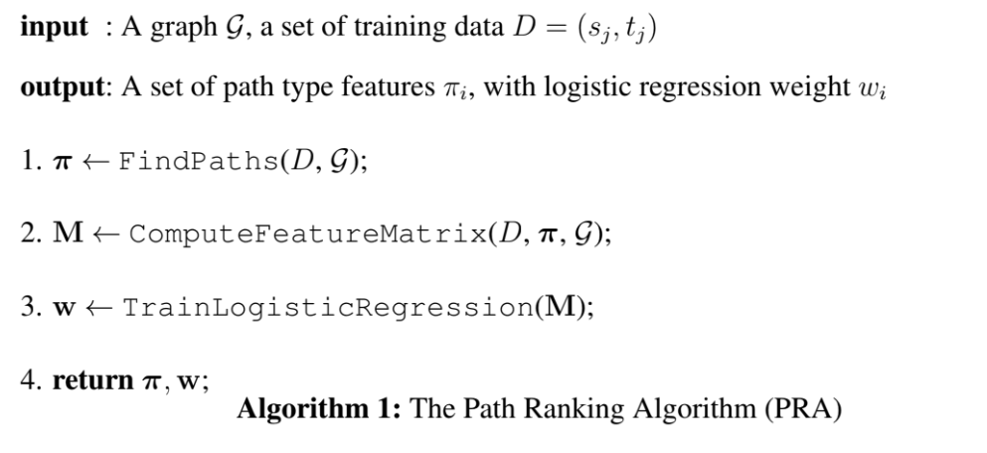
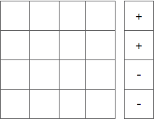
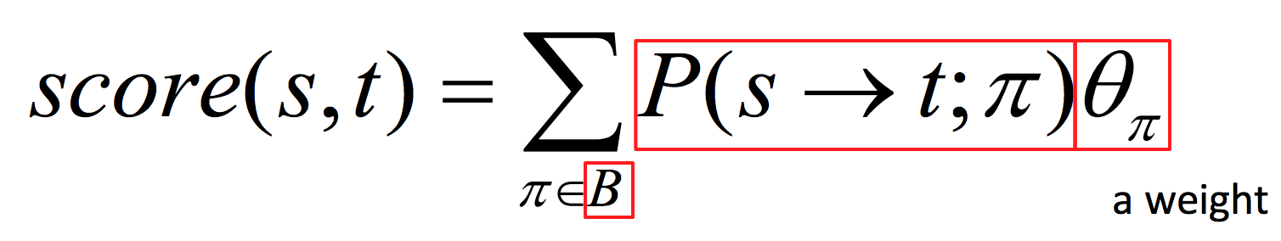
Path Based Approaches
Path Ranking Algorithm (PRA)
Feature matrix
Paths as features
Adapted from ICDM 2017 slide (Shiralkar, P. )
Node pairs
Probability of following a particular typed path as a feature (by random walks)
Relational retrieval using a combination of path-constrained random walks, Ni Lao and William W. Cohen., 2010.
Set of typed paths (sequence of typed edges)
Notes:
PRA learns to rank graph nodes y relative to a query node x by training a logistic regression to learn weights of path type(rules).
The key idea of PRA is to explicitly use paths that connect two entities as features to predict potential relations between them. Here a path is a sequence of relations ⟨r1, r2, · · · , rℓ⟩ that link two entities. , PRA then finds the paths by performing random walks over the graph, recording those starting from h and ending at t with bounded lengths.
Given a specific relation, random walks are first employed to find paths between two entities that have the given relation.
After that a set of paths are selected as features, according to some precision-recall measure (Lao et al., 2011), or simply frequency (Gardner et al., 2014).
Given an entity pair (h, t) and a path π, PRA computes the feature value as a random walk probability p(t|h, π), i.e., the probability of arriving at t given a random walk starting from h and following exactly all relations in π.
Gardner and Mitchell (2015) recently showed that such probabilities offer no discernible benefits. So they just used a binary value to indicate the presence or absence of each path. Similarly, Shi and Weninger (2015) used the frequency of a path as its feature value.
Random walk following a particular edge type sequence can encode certain meaning
Combine features from different edge type sequences

Slide 16
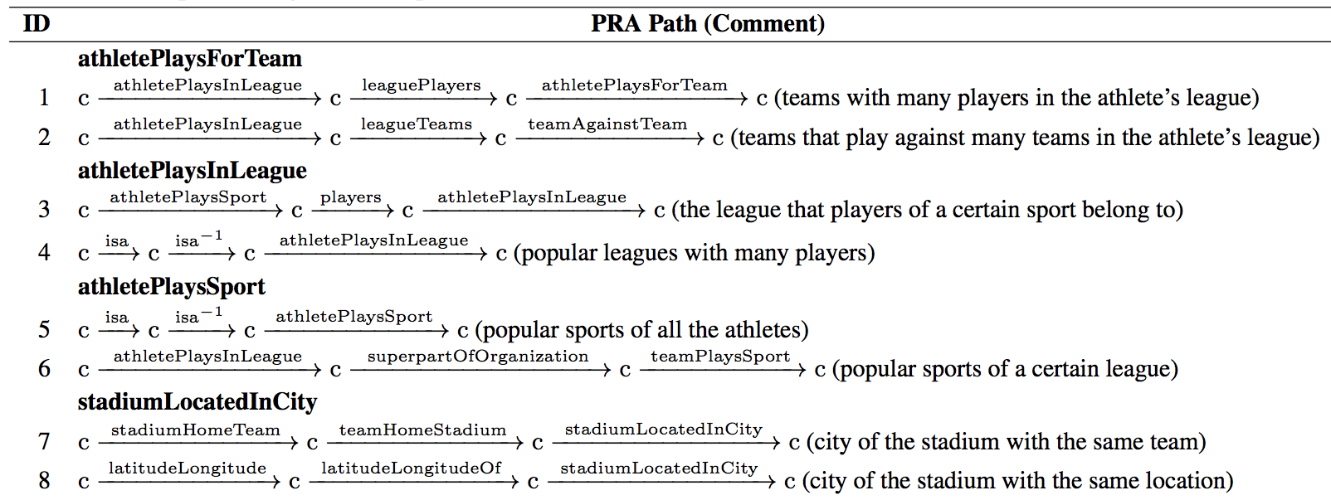
PRA - Ranked Paths
Simple, intuitive explanation

Slide 17
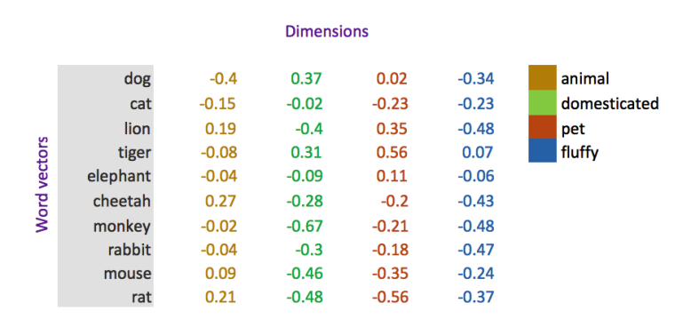
Embedding Approaches
Embedding approaches embed an entity into a multidimensional vector while a relation is represented as an operation (e.g., translation)
Notes:
Specifically, given a KG, entities and relations are first represented in a low-dimensional vector space, and for each triple, a scoring function is defined to measure its plausibility. Then, the representations of entities and relations (i.e. embeddings) are learned by maximizing the total plausibility of existing facts.

Slide 18
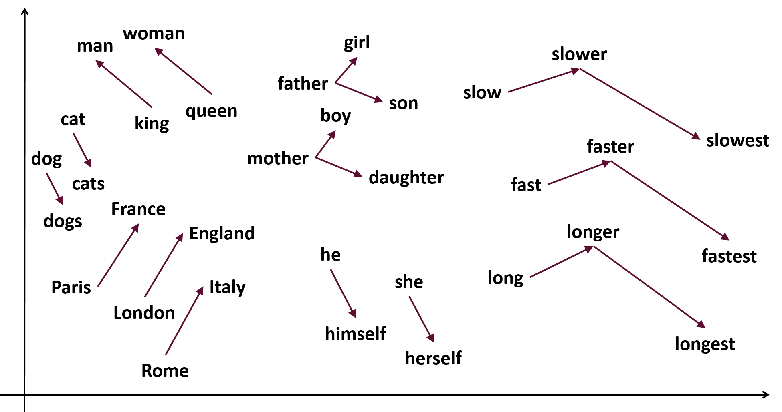
Low-dimensional vector embeddings
Instead of representing a word/text/entity/relation/graph with a symbol, map them into vector space.
Each word = a vector, not just "word" or word45.
Similar words are "nearby in space"

Slide 19
word2vec
Represent each word with a low-dimensional vector, called word embedding where semantically and syntactically closer words appear closer in the vector space.
Word similarity = vector similarity
Key idea: Train a classifier to predict surrounding words of every word
Distributed Representations of Words and Phrases and their Compositionality, Mikolov T. etl., 2013.

Slide 20
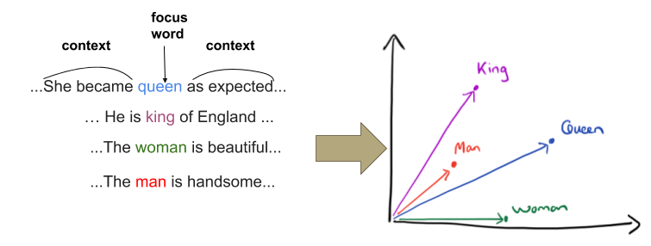
word2vec
Use text as implicitly training data to learn
a neural network classifier
King - Queen = Man - Woman
King - Queen + Woman = ?

Slide 21
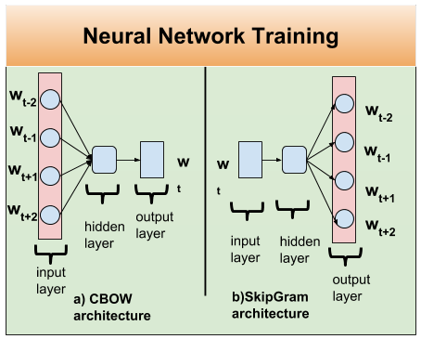
word2vec architectures
2 basic neural network models:
Continuous Bag of Word (CBOW):
use a window of word to predict the target word
Skip-Gram (SG):
use a word to predict the surrounding ones in window.

Slide 22
Skip-Gram Algorithm
Treat the target word and a neighboring context word as positive examples.
Randomly sample other words in the lexicon to get negative samples
Use logistic regression to train a classifier to distinguish those two cases
Use the weights as the embeddings

Slide 23
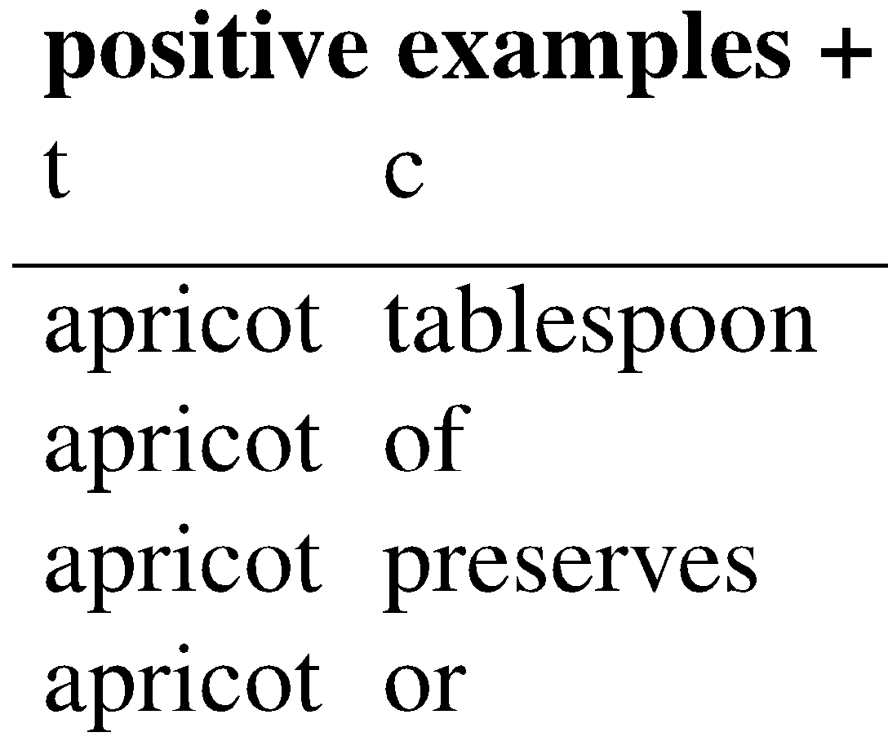
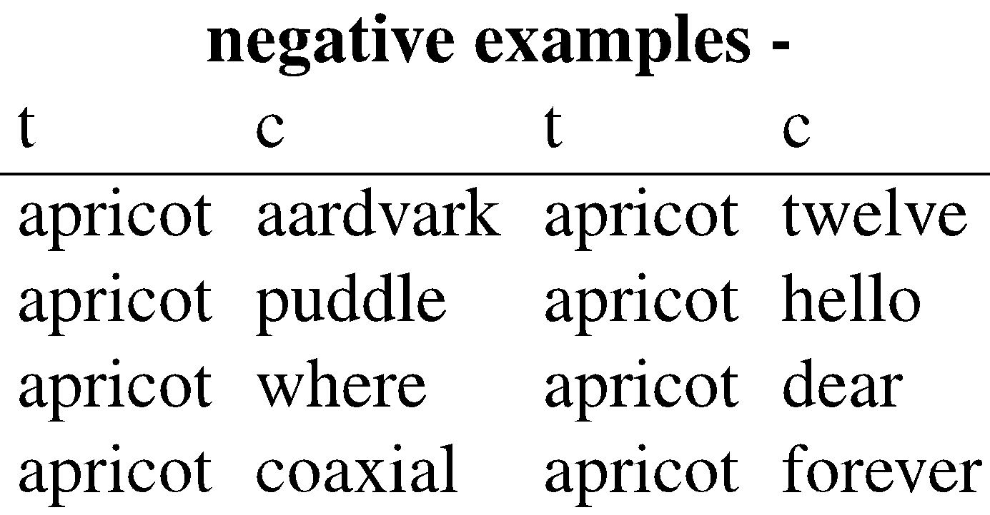
Skip-Gram Training
context window size
= +/-2
Training sentence:
... lemon, a tablespoon of apricot preserves or a pinch
c1 c2 t c3 c4

Slide 24
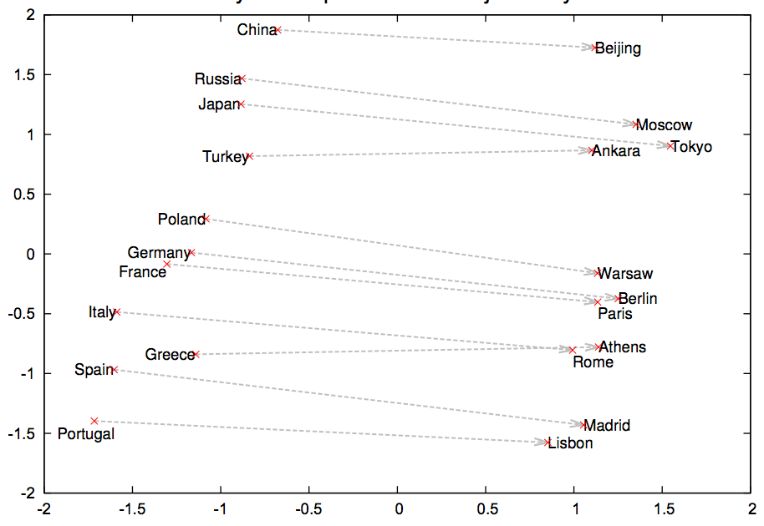
Word analogies
Linear relationship between capitals and countries.
We can predict the country of a given capital or the capital of a given country using vector difference.

Slide 25
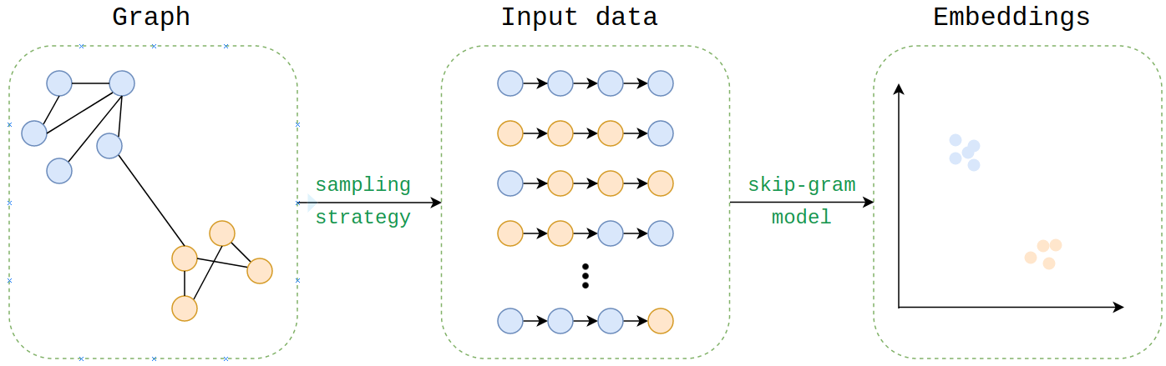
RDF2Vec
generated walks on the knowledge graph data to be used as input for word2vec neural network
Rdf2vec: Rdf graph embeddings for data mining. Ristoski, Petar, and Heiko Paulheim. International Semantic Web Conference. Springer, Cham, 2016.

Slide 26
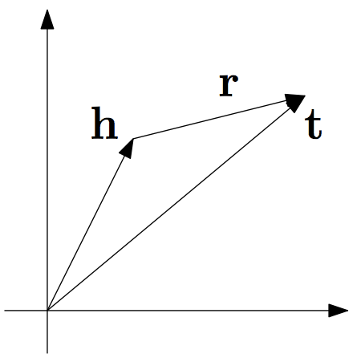
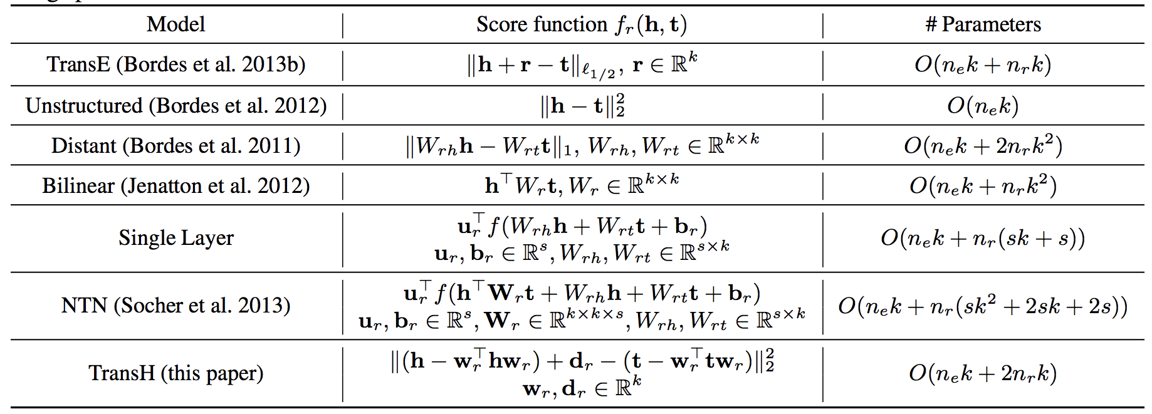
Knowledge Graph Embedding
Intuition: Predicate embedding captures the relation (+/x) between subject and object embeddings
Table from Wang et al. (AAAI 2014)
Accurate, but low interpretability

Slide 27
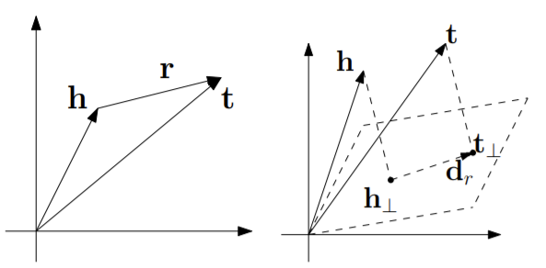
Translation based Embeddings
Many ways to model the problem: entities are usually vectors, relations could be vectors or matrices
TransE
TransH
Notes:
trains an artificial neural network model for each (head <h>, relation <r>, tail <t>) triplet to minimize the difference between vectors representing h + r and t

Slide 28
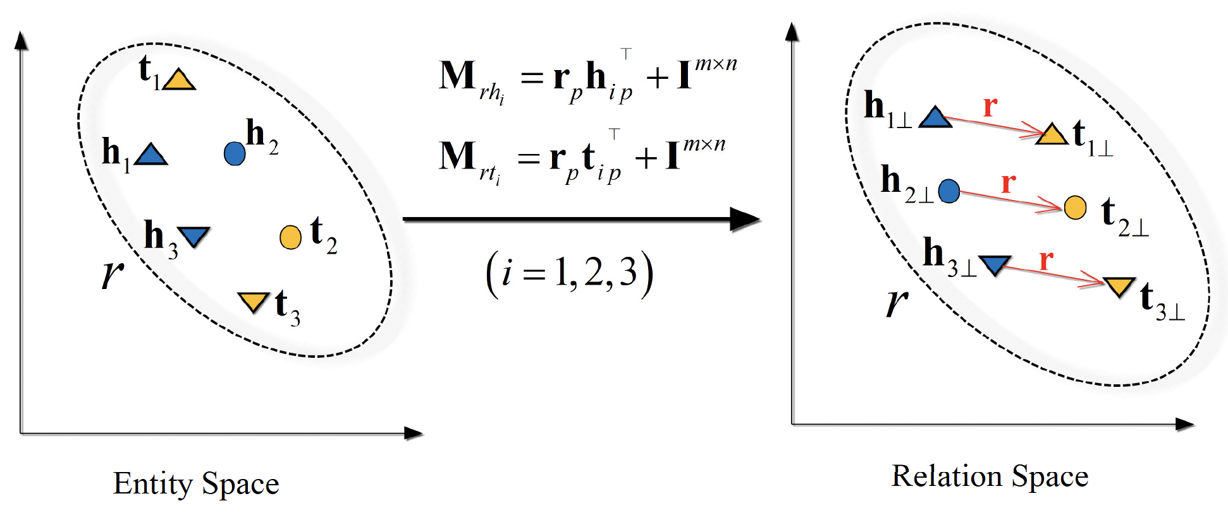
TransD
represents each entity and relations by two vectors; embedding vector and projection vector. 1-N, N-1 and N-M relationships can be handled.

Slide 29
References
N. Lao and W. W. Cohen. Relational retrieval using a combination of path- constrained random walks. Machine learning, 81(1):53–67, 2010.
Ni Lao, Tom Mitchell, and William W. Cohen. 2011. Random walk inference and learning in a large scale knowledge base. EMNLP 2011.
Landwehr, Niels et al. nFOIL: Integrating Naïve Bayes and FOIL. AAAI (2005).
Galárraga, Luis et al. AMIE: association rule mining under incomplete evidence in ontological knowledge bases. WWW (2013).
Bordes, A., Usunier, N., García-Durán, A., Weston, J., & Yakhnenko, O. (2013). Translating Embeddings for Modeling Multi-relational Data. NIPS.

Slide 30
References
Bordes, A., Usunier, N., García-Durán, A., Weston, J., & Yakhnenko, O. (2013). Translating Embeddings for Modeling Multi-relational Data. NIPS.
Lin, Y., Liu, Z., Sun, M., Liu, Y., & Zhu, X. (2015). Learning Entity and Relation Embeddings for Knowledge Graph Completion. AAAI.
Shi, B., & Weninger, T. (2017). ProjE: Embedding Projection for Knowledge Graph Completion. AAAI.
Wang, Z., Zhang, J., Feng, J., & Chen, Z. (2014). Knowledge Graph Embedding by Translating on Hyperplanes. AAAI.
Yang, B., Yih, W., He, X., Gao, J., & Deng, L. (2014). Embedding Entities and Relations for Learning and Inference in Knowledge Bases. CoRR, abs/1412.6575.

Slide 31
References
Shiralkar, P., Flammini, A., Menczer, F., & Ciampaglia, G. L. (2017, November). Finding streams in knowledge graphs to support fact checking. In 2017 IEEE International Conference on Data Mining (ICDM) (pp. 859-864). IEEE.

Slide 32
Questions?

